Slide 1
Kujushiji MNIST - Classifier
Hugo Coussens, Kevin Fung, Falola Yusuf and Nitchakul Pipitvej

Slide 2
Content
Introduction
Data Augmentation and Pre-processing
Network Architecture
Validation and Hyperparameter selection
Results and Discussion
Lesson Learnt and Challenges
Conclusion

Slide 3
Introduction
Kuzushiji MNIST contains 70,000 (28 x 28) grayscale images, 10 classes.
Convolutional neural networks based on AlexNet, and LeNet
Performance:
The Data
The Network architecture
A large array of Hyper-Parameters
ALL INTERDEPENDENT

Slide 4
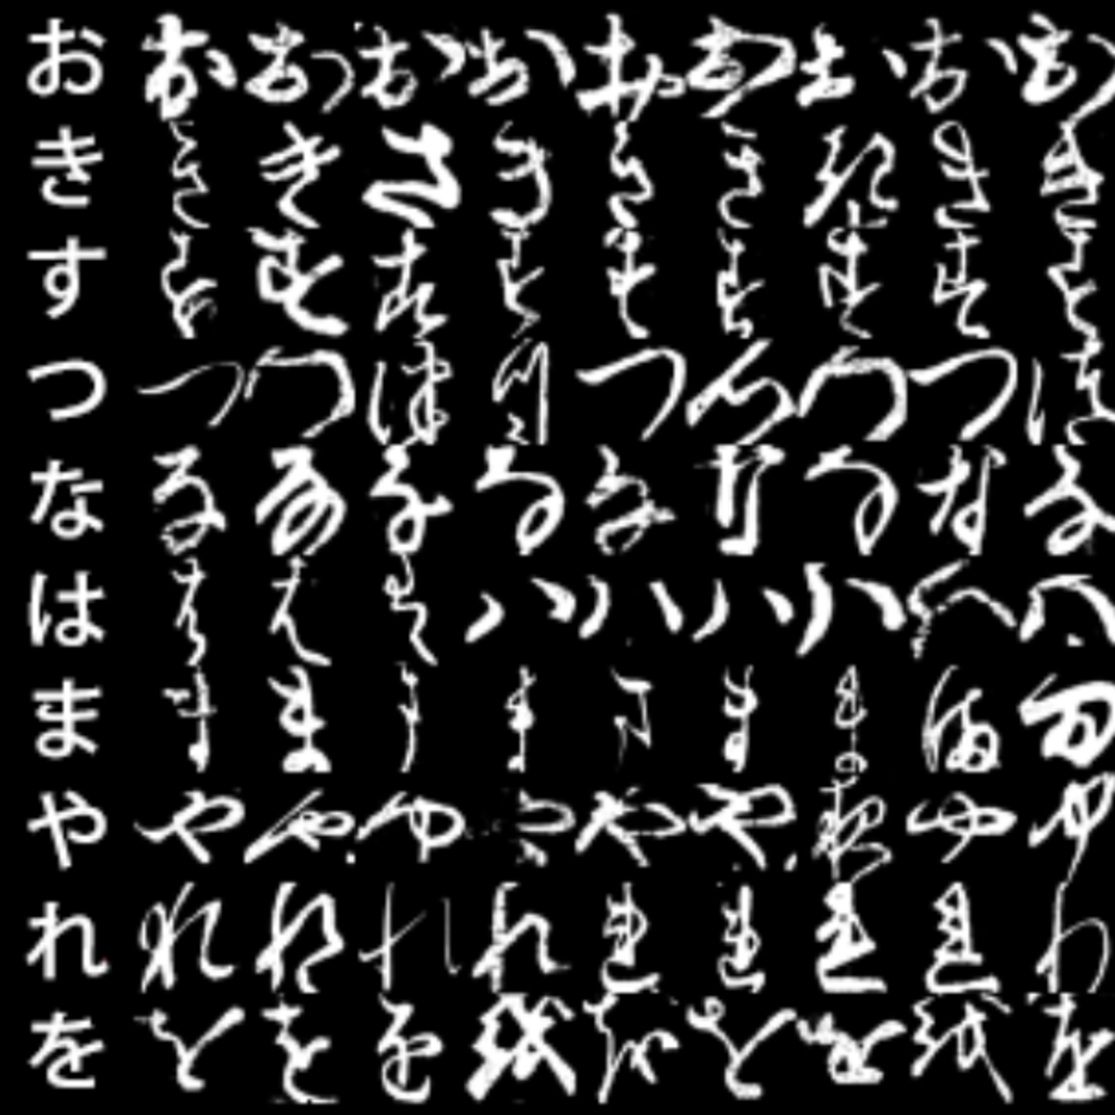
Data Augmentation and Pre-processing (1)
Extreme variation of shapes within each class.
The bigger the dataset the better
Augmentation increases variation in training data.

Slide 5
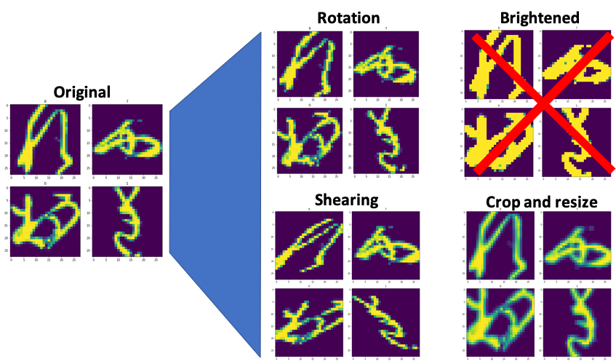
Data Augmentation and Pre-processing (2)

Slide 6
Data Augmentation and Pre-processing (3)
Implementation:
At each epoch
Random magnitude of each transform
Random transform selected for each image
Benefits:
Maintain small dataset
Quick epochs = quick training
Larger overall variation of data seen by model
Size of TOTAL SEEN data = dataset*epochs,
vs simply a reused dataset augmented once
Memory vs Computation trade off!

Slide 7
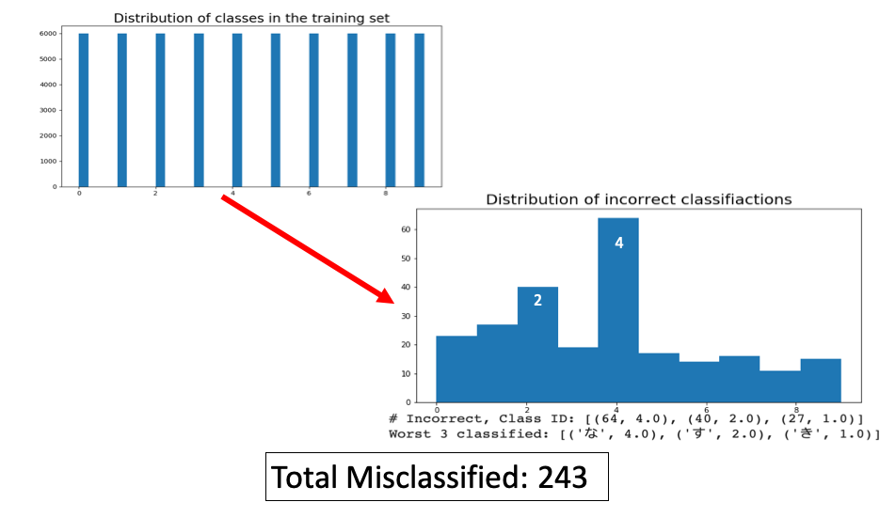
Data Augmentation and Pre-processing (4)
incorrectly classified classes

Slide 8
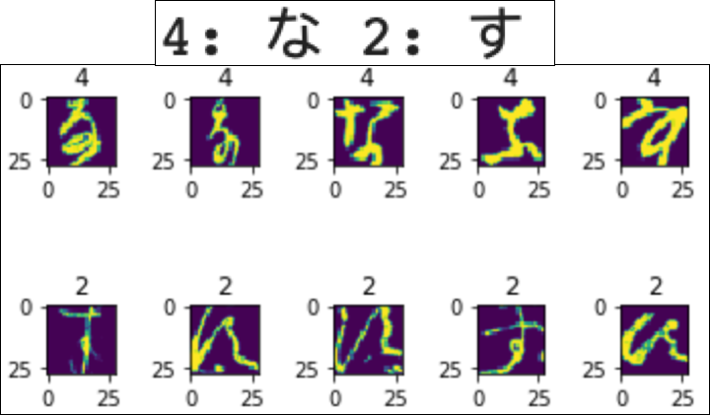
Data Augmentation and Pre-processing (5) - The poorly predicted classes

Slide 9
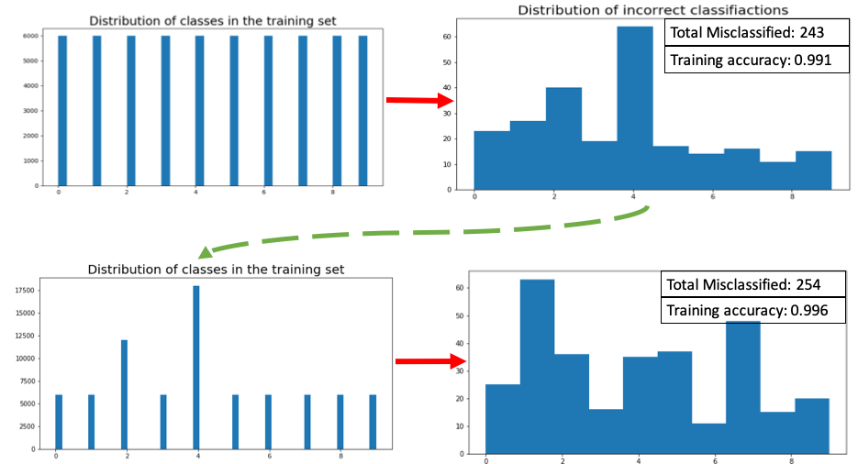
Data Augmentation and Pre-processing (6)
Input Distribution
incorrectly classified classes:
Input Distribution
incorrectly classified classes:

Slide 10
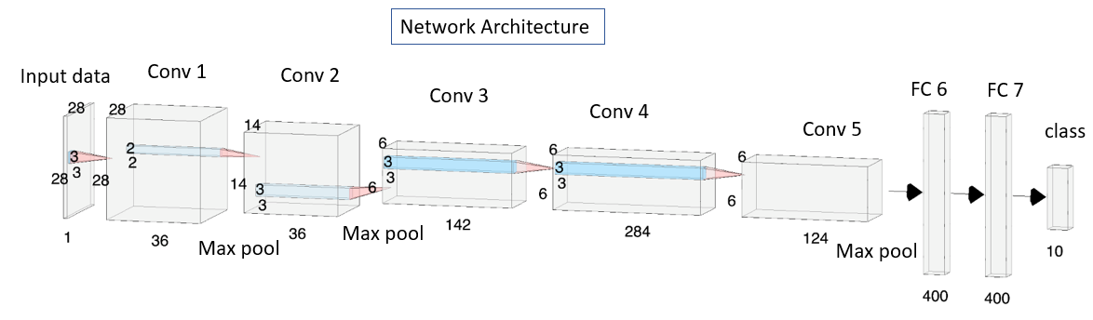
Network Architecture

Slide 11
Validation and Hyperparameter Tuning
Hold-Out Validation
K-Fold Cross Validation
Random-Grid Search
On learning rate and weight decay ( 15 iteration )

Slide 12
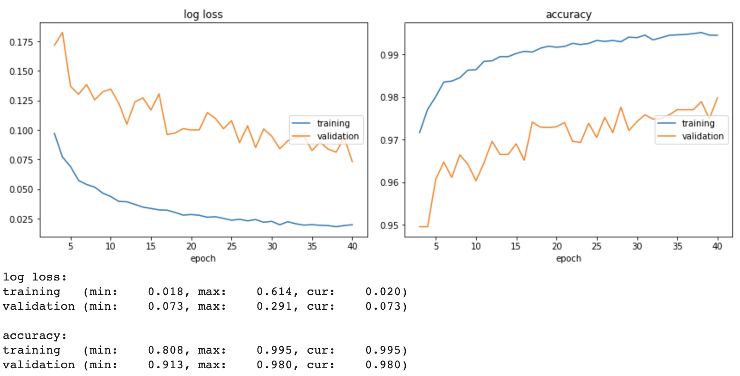
Results and Discussion
Learning rate = 7.e-05
Weight Decay = 7.e-04
batch_size = 64
test_batch_size = 1000
n_epochs = 40
Dropout = 70%
Batch Normalization

Slide 13
Lesson Learnt and Challenges
Lesson Learnt | Challenges
Data Augmentation Random-grid search Network tuning | Architecture ensembling

Slide 14
Conclusion
Three networks were created from LeNet and AlexNet, a modified AlexNet was selected as final network.
Modifications made to the basic AlexNet include: input and output channels alteration, dropout, 2D batch normalisation.
Data augmentation and pre-processing were done to make model more robust
Implemented random-grid search for hyper parameters selection.
Final accuracy of 97.914% on the test set, surpassing the GTA baseline of 96.228%.
Consideration of other networks; ReNet, VGG, and so on to improve accuracy in future work.

Slide 15


